Slide 1

Introduction
Sibling Rivalry
Names: [Insert Names]
Course: Families in Transition
Why we chose this topic:
Common in many families
Impacts children’s emotional and social development
Notes:
Hello everyone, today we will be presenting on sibling rivalry. We decided to write about this issue as it is an extremely widespread family phenomenon and may considerably influence the emotional state of children and their relations. With the future of education under our belt, a knowledge of sibling rivalry will assist us in advancing the support of children and their families in the process of transition.

Slide 2
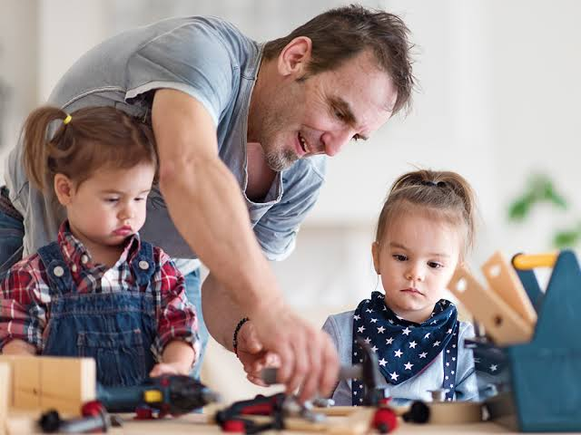
What is Sibling Rivalry?
Conflict, jealousy, and competition between siblings
Frequently starts when a new baby is born.
May happen at any age.
Linked to need for attention and validation (Rebar et al., 2020)
Notes:
Sibling rivalry is a conflict, jealousy and rivalry between siblings. Rebar et al. (2020) notes that it can start with the introduction of a new child into the family because the elder child might feel that his/her position is at risk. Nevertheless, competition is possible at all ages. Parents tend to give attention, love, and approval towards their children, and this can be a cause of emotional tension among children.

Slide 3
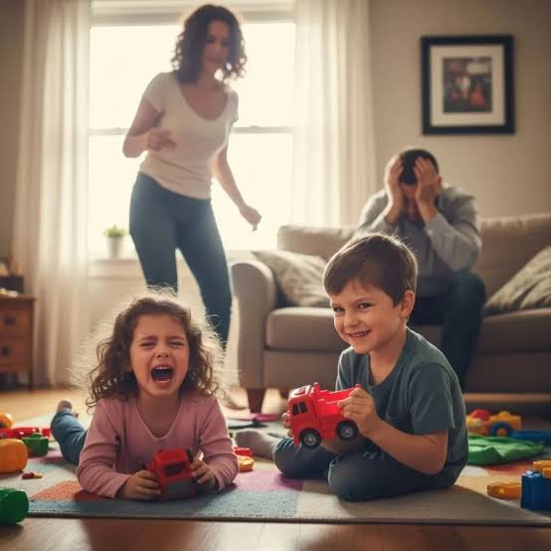
The causes and effects of Sibling Rivalry
Age differences
Personality differences
Parenting styles
Effects:
Aggression or conflict
Low self-esteem
Development of social skills
Notes:
Age difference, personality differences, and the manner in which parents treat the children are some of the factors that may cause sibling rivalry. According to Holmes et al. (2024). These differences may bring about rivalry and misinterpretations. Rebar et al. (2020) cites cases of negative effects such as aggression and low self-esteem as an outcome of sibling rivalry. Nevertheless, it can also be beneficial, including the way of teaching children essential social skills, including negotiation and resolving conflicts.

Slide 4
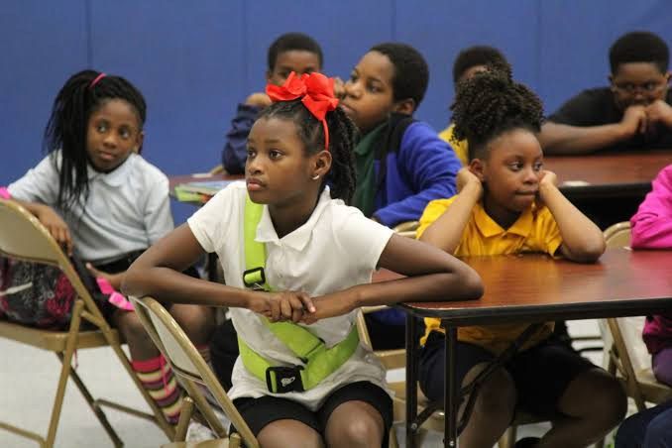
Strategies for Educators
Teach conflict resolution skills
Promote openness and expression of emotions.
Support each child’s individuality
(Suresh & Chandran, 2020).
Notes:
Teachers can help the children who have sibling rivalry. One of these strategies is teaching conflict resolution skills, which includes sharing and taking turns. Suresh and Chandran (2020) stress that it is necessary to assist the children in expressing their feelings in the most effective ways. Also, encouraging individuality of the child leads to decreasing competition because, according to McHale and colleagues (2012), when every child is aware of his or her strengths, comparison and jealousy among them can be minimized.

Slide 5
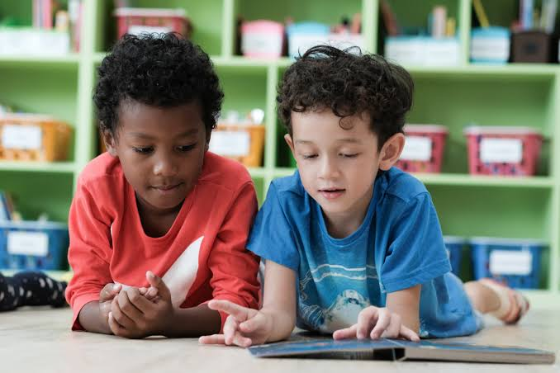
Children’s Books
Teach conflict resolution skills
Encourage communication and emotional expression
Support each child’s individuality
Fitri and Erwinda (2024).
Notes:
These books concerning children are useful in dealing with sibling rivalry. They present stories that people can relate to and learn how to relate well with their siblings in a positive manner. The book I Love My Brother by Joe Cepeda is particularly significant because it is more inclusive to children with various backgrounds as it reflects a variety of voices and opinions (Kpea, 2026).

Slide 6
Community Resources (Toronto)
SickKids Hospital
Resources on parenting and child development.
https://www.sickkids.ca
Toronto Public Health
Parenting training and workshops.
https://www.toronto.ca
Video:
How to Deal with Sibling Rivalry (YouTube).
Describes family causes and strategies.
Notes:
The community resources can also be used by families. SickKids Hospital provides quality child development and family support information. Trew (2025) portray Toronto Public Health has parenting programs that enable families to cope with issues such as sibling rivalry. Also, the suggested video describes the reasons of sibling rivalry, as well as provides useful strategies that can be implemented by both parents and children (Reghintovschi, 2025).

Slide 7
References
Fitri, R. A., & Erwinda, L. (2024). The influence of toxic parenting on sibling rivalry among high school students. Journal of Counseling and Educational Research, 1(2), 91–98. https://doi.org/10.63203/jcerch.v1i2.120
Holmes, M. R., O’Donnell, K. A., Lovato, K., Kramer, L., Korsch-Williams, A. E., Herceg, A. E., & Stephens, S. O. (2024). Exploring sibling relationship quality among Latinx siblings: A systematic review. Behavioral Sciences, 14(7), 624. https://doi.org/10.3390/bs14070624
Kpea, K. C. (2026). Sibling rivalry in dysfunctional families and its toll on maternal mental health: A scoping review. Discover Public Health, 23, 214. https://doi.org/10.1186/s12982-026-01552-7
Rebar, D., Bailey, N. W., Jarrett, B. J. M., & Kilner, R. M. (2020). An evolutionary switch from sibling rivalry to sibling cooperation, caused by a sustained loss of parental care. Proceedings of the National Academy of Sciences, 117(5), 2544–2550. https://doi.org/10.1073/pnas.1911677117⁠�
Reghintovschi, S. (2025). The unconscious sibling rivalry in psychoanalytic institutions. Frontiers in Psychology, 15, 1510824. https://doi.org/10.3389/fpsyg.2024.1510824
Suresh, J., & Chandran, N. (2020). Sibling rivalry: An under-rated entity of the little minds? International Journal of Indian Psychology. https://doi.org/10.25215/0803.069
Trew, S. (2025). Close relationships despite the challenges: Sibling relationships and autism. Journal of Autism and Developmental Disorders, 55, 2989–3001. https://doi.org/10.1007/s10803-024-06412-4
Notes:
These are the academic references that we used in our presentation. They encompass scholarly publications and our course textbook, which gave evidence-based data concerning sibling relationships and family transitions.

Slide 8
Group Contributions
[Name]: Slides 1–3, research
[Name]: Slides 4–6, research
[Name]: Slides 7–8, editing & design
Recording was equally the contribution of all members.
Notes:
All the members of the group played an equal part in this project. We shared the slides and research duties with each other and jointly edited and recorded so that we could have a balanced and unified presentation.

